Slide 1
Neo- Classical Theory & Modern Theory

Slide 2
Learning Outcome
Students will understand neo classical management thoughts and modern theory.

Slide 3
MCQ
Management skills applies to managers at _____
A. Middle levels in an organization
B. Top levels in an organization
C. Executive levels in an organization
D. All levels in an organization

Slide 4
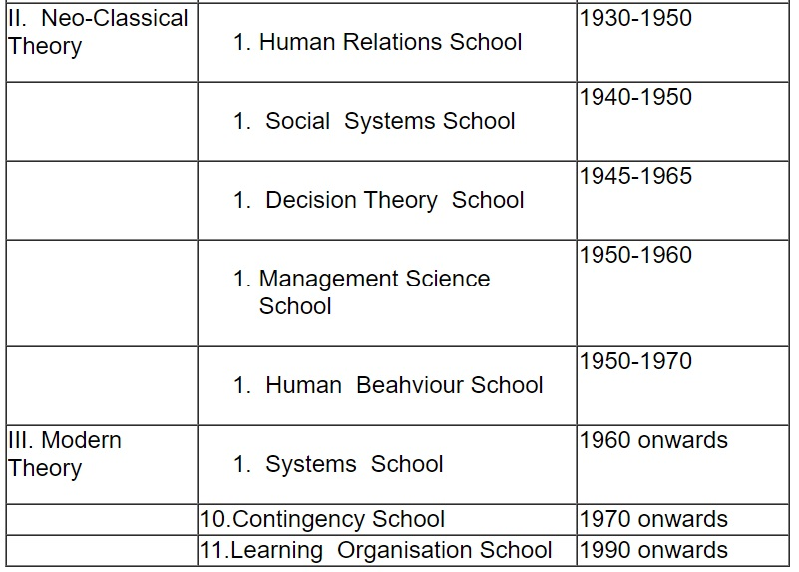
Neo- Classical Theory & Modern Theory

Slide 5
Neo- Classical Theory & Modern Theory
The schools of management thoughts developed during the period 1930’s to 1960’s are known as ‘Neo-Classical School of Thought’
Human Relations School
Prominent advocate of this approach was Elton Mayo. Two other co- researchers of this school were F.J. Roethlisberger and William J. Dickson.
They conducted studies at Hawthorne Illinois plant of Chicago Western Electric Company, which became famous as ‘Hawthorne Experience’ or ‘Hawthorne Studies’ later.
Developed during the middle of the 20th Century, this approach emphasizes the complexity of mankind and devotes much more attention to the satisfaction of human needs within the organisations.

Slide 6
Neo- Classical Theory & Modern Theory
The main assumptions of the ‘Human Relations School’ are as under:
(i) As management is a process of getting things done by people, managers should understand human behaviour;
(ii) Motivation and good human relations should be the base for better productivity ; and
(iii) Motivation, leadership, communication, participative management and group dynamics are the major themes of this approach.

Slide 7
Neo- Classical Theory & Modern Theory
Social Systems School
Chester I. Barnard is considered the father of the ‘Social-Systems School’, which is sociologically oriented.
Barnard developed a theory of cooperation based on the need of the individual to offset personal, biological, physiological and sociological limitations.
It defines cooperation as a system in which people are able to communicate with one another and willing to coordinate their efforts to a unified end result.
Thus, many non–logical factors also enter into organisational analysis. Therefore, the reasons for an action should not only be logical but must appeal to those attitudes, pre-dilections, prejudices, emotions and mental background that cover action.

Slide 8
Neo- Classical Theory & Modern Theory
Decision Theory School
Major contribution of this school of thought has come from Simon. Manager is a decision- maker while organisation is a decision making unit.Decision- Theory School’ has the following features:
(i) Management is essentially decision making;
(ii) The members of the organisation are decision-makers and problem solvers;
(iii) Organisations can be treated as a combination of various decision centres. The level and importance of organisational members are determined on the basis of importance of decision which they have to make ;
(iv) Quality of decisions affect the organisational effectiveness ; and
(v) All factors effecting decision -making are the subject matter of study of management.

Slide 9
Neo- Classical Theory & Modern Theory
Management Science School
It is also known as ‘Mathematical school’ or ‘Quantitative Measurement school’. It is a system that can be understood by many people who have no particular grasp of the concepts of management itself, but who can understand the mathematical symbols. The major features of this school of thought are as under:
(i) Management is regarded as the problem solving mechanism with the help of mathematics tools and techniques.
(ii) Management problems can be described in terms of mathematical symbols and data. Thus every managerial activity can be quantified.
(iii) This approach covers decision making, systems analysis and some aspects of human behaviour.
(iv) Operations research, mathematical tools, simulation, models, etc. are the basic methodologies to solve managerial problems.

Slide 10
Neo- Classical Theory & Modern Theory
Human Behaviour School
This school of management thought is also known as ‘Behavioural Science School’, or ‘Human Resource School’, ‘Leadership School’ of thought.
‘Human Behaviour School’ has been goal and efficiency oriented and considers the understanding of human behaviour to be the major means to that end.
This school emphasizes human resources in an organisation more as compared to physical and financial resources.

Slide 11
Neo- Classical Theory & Modern Theory
Modern Theory(1960 onwards)
Systems Approach or System School
One of the most widely accepted theoretical basis for modern management is called ‘Systems Approach’ or ‘Systems School’.
The system is influenced by the environment and in turn influences the environment.
The systems approach to management acknowledges the impact of the outside environment on everything that happens within an organisation.
System theory envisions organisations as porous entities that are greatly affected by the outside environment.

Slide 12
Neo- Classical Theory & Modern Theory
Contingency Approach or Contingency School
It is also known as ‘Situational Approach’. The basic idea of Contingency Approach is that there cannot be a particular management action which will be suitable for all situations.
The Contingency Approach or Situation Approach asserts that:
(i) There is no best managerial technique ;
(ii) There is no best way to manage;
(iii) No technique or managerial principle is effective all of the time ; and
(iv) Should the question be posed as to what works best, the simple response is-‘It all depends on the situation’.

Slide 13
Neo- Classical Theory & Modern Theory
Learning Organisation School
This approach was first put forth by Peter Senge during 1990s. As the name implies, a ‘Learning Organisation’ is one in which all employees are constantly learning. The basic principles of the Learning Organisation School are as follows:
(i)Personal mastery with people identifying what is important in the process;
(ii)Mental models, with the organisation continuously challenging members in order to improve their mental models;
(iii)Shared vision, requiring an imagining of what the organisation should be;
(iv)Team learning, through cooperation, communication, and compatibility; and
(v) Systems thinking, recognizing the organisation as a whole.

Slide 14
MCQ
Chester I Barnard is considered as the father of the following school of management thought:
Operational Management School
Contingency School
Social-Systems School
Decision Theory School

Slide 15
Thank You

